Slide 1
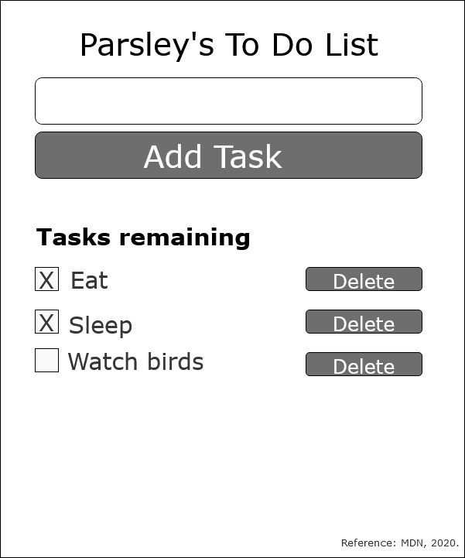
React To-Do Planning Assignment

Slide 2
1
The Main Container of To-Do Task – This container component will show page for the user. This container include components: input task form, add task button, task list, delete buttons (Fesehatsion, 2019).
1
Input Form Component – This should allow user to input task. This contain functional components to just receive props as arguments and return JSX to be rendered. This component will only have one prop to handle the click event for adding a new to-do (Nwamba, 2016).
2
To-Do List Component – This component should include <ul> that contains a loop of to-do components made of <li> (Nwamba, 2016).
3

